Slide 1
Compensation Plan ORIENTATION
June 20, 2017

Slide 2
Compensation Plan ORIENTATION
What we will cover
Prior to 1st of July:
End of BP7 activities
Power Bonus
After 1st of July:
Pricing
Loyalty Credits
Enrolments (up to 1st of October then switches over to new process)
AO generation
End of Month process
Cheques

Slide 3
WHAT HAPPENS JUNE 30, 2017?
End Achievers Club Incentive.
End of Recruit Boost Incentive.
End of Power Bonus.
Hard Close of BP 7 at 9pm Sydney time
(no exceptions!)

Slide 4
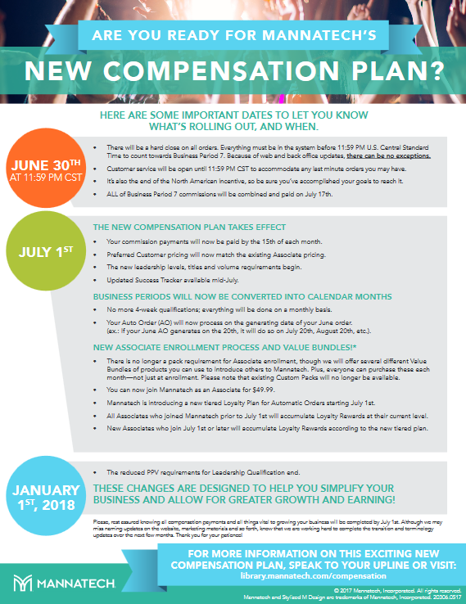
WHAT HAPPENS JUNE 30, 2017?
Compensation Plan
Transition Flyer
(Effective July 1, 2017)

Slide 5
1st JULY!

Slide 6
1st July - Pricing
Customers will now pay the same price for their products as the Associates!

Slide 7
LOYALTY - PREFERRED CUSTOMERS

Slide 8
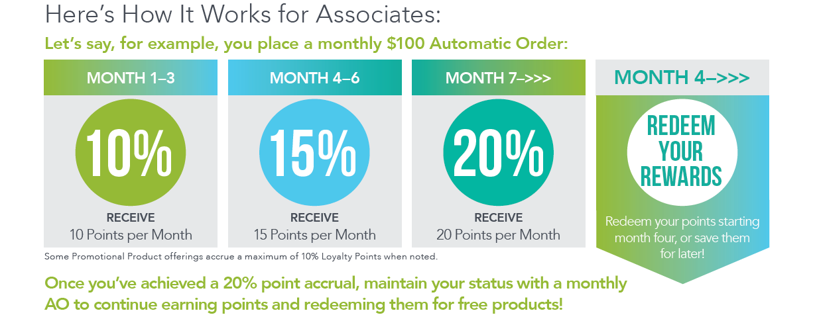
LOYALTY- ASSOCIATES

Slide 9
WHAT HAPPENS JULY 01, 2017
New Enrollment Process (Preferred Customer/Associate)
Auto Orders continue on same date going forward.
End of the Month Close process.
When do commissions pay?

Slide 10
NEW ENROLLMENT PROCESS
Prior to 1st October ENROLLMENT PROCESS
will continue with Packs*
* First Order Bonus does not apply to $12 pack
1st October ENROLLMENT PROCESS
Will switch to the new enrolment process …
Associate Fee, no Enrollment Packs & New Online Process

Slide 11
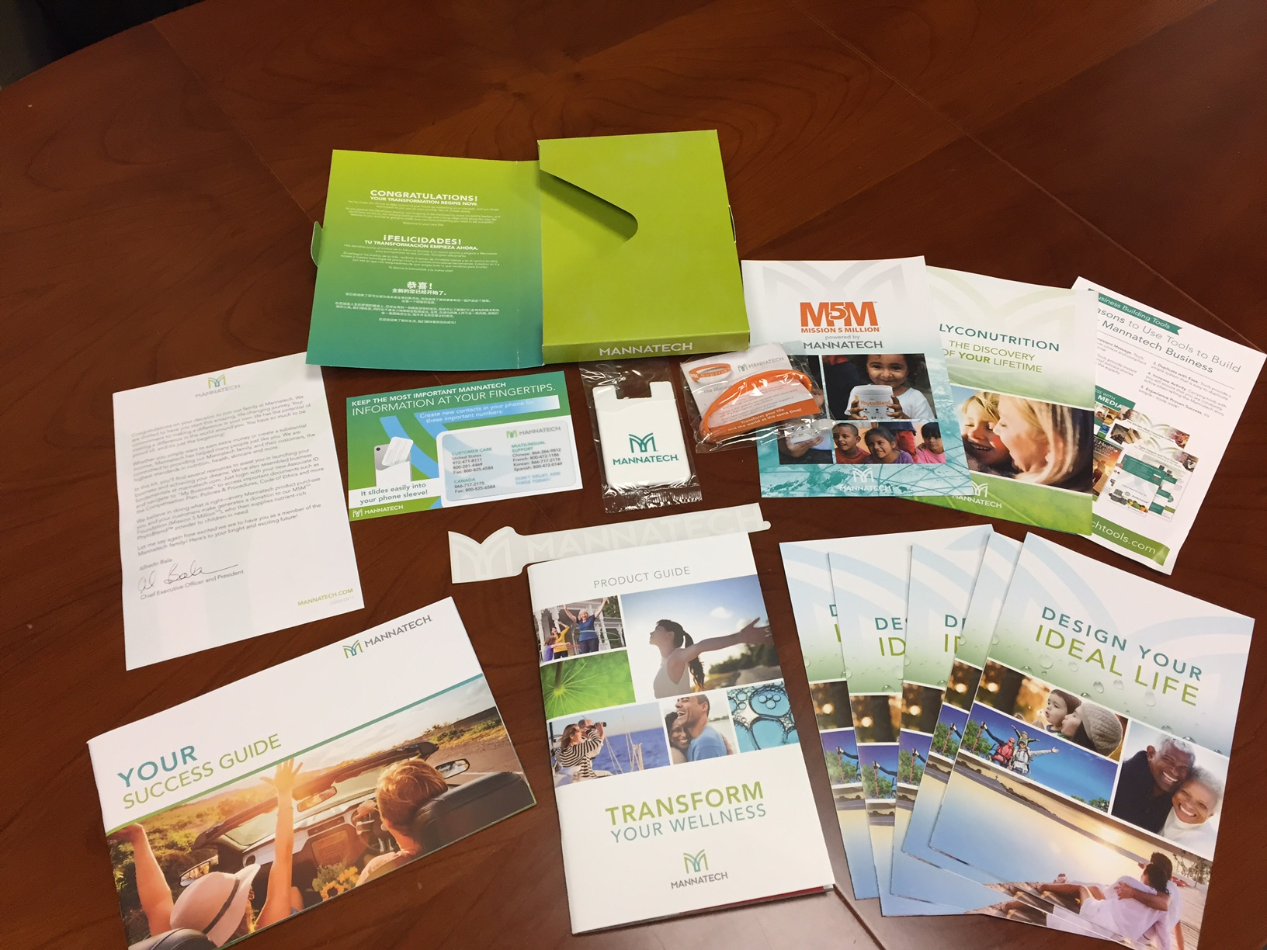
ASSOCIATE REGISTRATION FEE
The turn key business includes:
Welcome Kit.
The tools include:
Success Tracker
Mannatech + app
You get Desktop Versions &…
Multiple personalized web pages
Customer Relationship Management tools
The “to do” dashboard
Media library
(makes posting/emailing/texting easier and more effective)
Email campaigns
Auto responders
Full campaign reporting and more…

Slide 12
WHAT HAPPENS JULY 01, 2017
New Enrollment Process (Preferred Customer/Associate)
Auto Orders continue on same date going forward.
End of the Month Close process.
When do commissions pay?

Slide 13
AO GENERATION
AOs will now generate on the date the associates set on each month. E.g. if set on the 20th the AO will generate on the 20th of each month.
Any AO that are scheduled to generate in a month where there on no date (e.g. 30th or 31st) it will generate early and will resume its normal generation the following month.

Slide 14
WHAT HAPPENS JULY 01, 2017
New Enrollment Process (Preferred Customer/Associate)
Auto Orders continue on same date going forward.
End of the Month Close process.
When do commissions pay?

Slide 15
MONTH END CLOSE
When the Month Ends, Mannatech will add One Business Day before the Hard Close Process occurs. This allows our Leaders the opportunity should they need it to place orders and have them backdated to the prior month in order to qualify for their desired Leadership Rank.

Slide 16
WHAT HAPPENS JULY 01, 2017
New Enrollment Process (Preferred Customer/Associate)
Auto Orders continue on same date going forward.
End of the Month Close process.
When do commissions pay?

Slide 17
WHEN DO CHECKS POST?
You get paid around the 15th of a month in the new plan.
August 15th, 2017 will be the first time you get paid in the new plan!

Slide 18
IMPORTANT DATES …
30TH JUNE – END OF BP 7
1ST JULY – NEW COMPLAN STARTS
WEEK OF 17TH JULY – BP7 CHEQUES / NEW SUCCESS TRACKER
15TH AUGUST – FIRST CHEQUE UNDER THE NEW COMPLAN
1ST OCTOBER – TRANSITION INTO CAP

